Slide 1
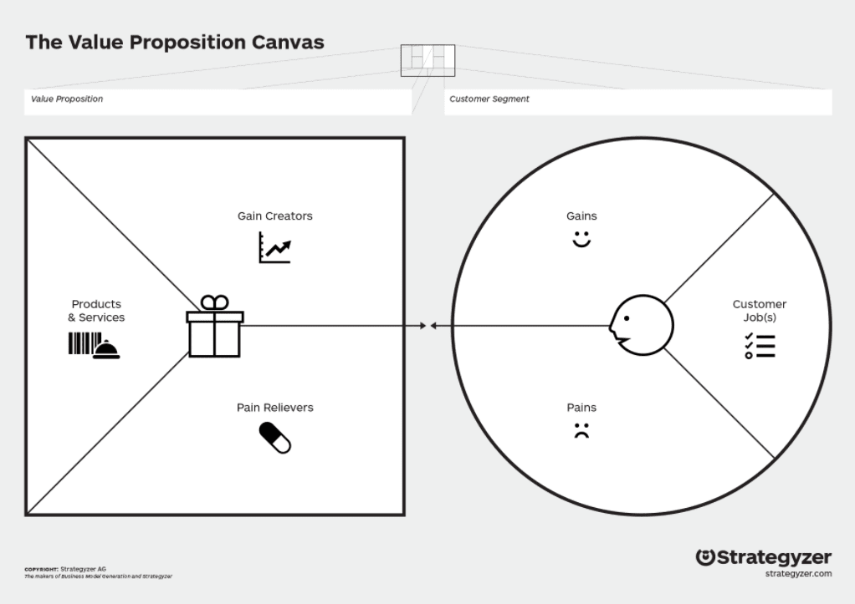
Diverse team in place with different backgrounds and skillsets to help solve complex issues more effectively
I have worked for a few large organisations e.g. RBS, Cooperative, Tui, Love Holidays
Increase in quality and productivity
Reliable Junior staff members make it much easier for senior staff to focus on their own jobs and be great for morale
Diverse team with different backgrounds and skillsets
The API (Application Programming Interface) will improve productivity by making us faster and more accurate.
Digitalising the P.C.O.S service due to the increase in demand has helped to alleviate the pressure exp by colleagues in the pension processing centres
Integration Teams enabling systems to connect with & share data / info across DWP, other Govt Depts & private sector partners
API will improve our reputation by offereing an improved user interface tailored to how they wish to interact with us e.g. web, telephone or video.
20 years sales experience – strong communication skills
Hunger to learn leads to better quality training
Good attention to detail will mean less mistakes.
Experience of working within teams all striving for the same goal. I have also played in football & rugby teams.
Recruit a divesre set of candidates for increased worload and to give us better persepective with potential future challenges
Semior Staff benefit from the enthusiam and new insights offered by Junior Staff.
Used to working evenings and weekends
Maintaining the new Pension Credit online service
API will require considerable man power to design and implement.
In process of switching from 23 integration systems towards a new API event driven architechure which will us to share data in a much more organised, consistent way.
Used to working towards & exceeding targets within a specified timeframe and striving to exceed expectation.
Very good puntuality and attendance.
I have OCD for making sure the job is done to the best of my ability.
Not all pc illiterate users of the P.C.O.S. have a digitally-literate family member to complete the application for them which can overwhelm colleagues in pensions processing centres
Used to working under pressure
A love for learning and ambition to succeed.
Recruit Senior, Junior and Entry level staff to assist with the increased workload & demand
Integration team consists of 110 people split into 11 teams, using 23 integration systems which can lead to mistakes and setbacks caused by communication failures or any lapses in concentration.
A github with approx 270 repository contributions over the past 12 months demonstrating a love for coding
I have a deep level of respect for the elderly and vulnerable and feel passionate about striving to help them enjoy the best quality of life possible
As an Apprentice/Junior I could add a diverse way of thinking stemming from the challenges both my parents faced as disabled teachers and a 20 year sales career at the front customer facing end.
Love to be part of a well gelled team and give maximum effort, plus assist any colleagues if they ask for my help.
Potential teething problems when we switch from integrated to API

